Slide 1

FIFA Statistics and Machine Learning
Group Members: Jacob Woolley, Viktor Bondarenko, Joseph Kennedy, Micah Korinek
Notes:
Viktor

Slide 2

Data Source
Wanted to work with sports statistics
Difficult to find large enough datasets
Kaggle.com Sports Data Analysis Usability: 8.53
Originally from sofifa.com
Companion to video game FIFA for data on choosing players
Notes:
Viktor

Slide 3

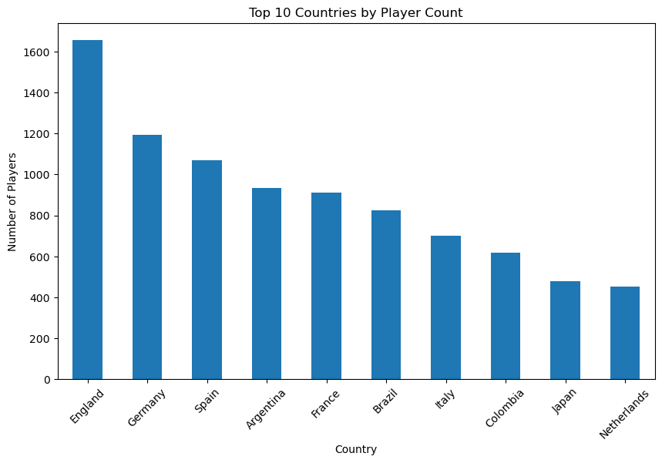
Our Dataset
Around 18,000 players
Calculating for player wage
Basic statistics (age, height, weight, etc.)
34 soccer statistics for each player (dribbling, ball control, stamina, etc.)
Rated from 1 to 100
Notes:
Viktor

Slide 4

Our Dataset
Around 18,000 players
Calculating for player wage
Basic statistics (age, height, weight, etc.)
34 soccer statistics for each player (dribbling, ball control, stamina, etc.)
Rated from 1 to 100
Notes:
Viktor

Slide 5
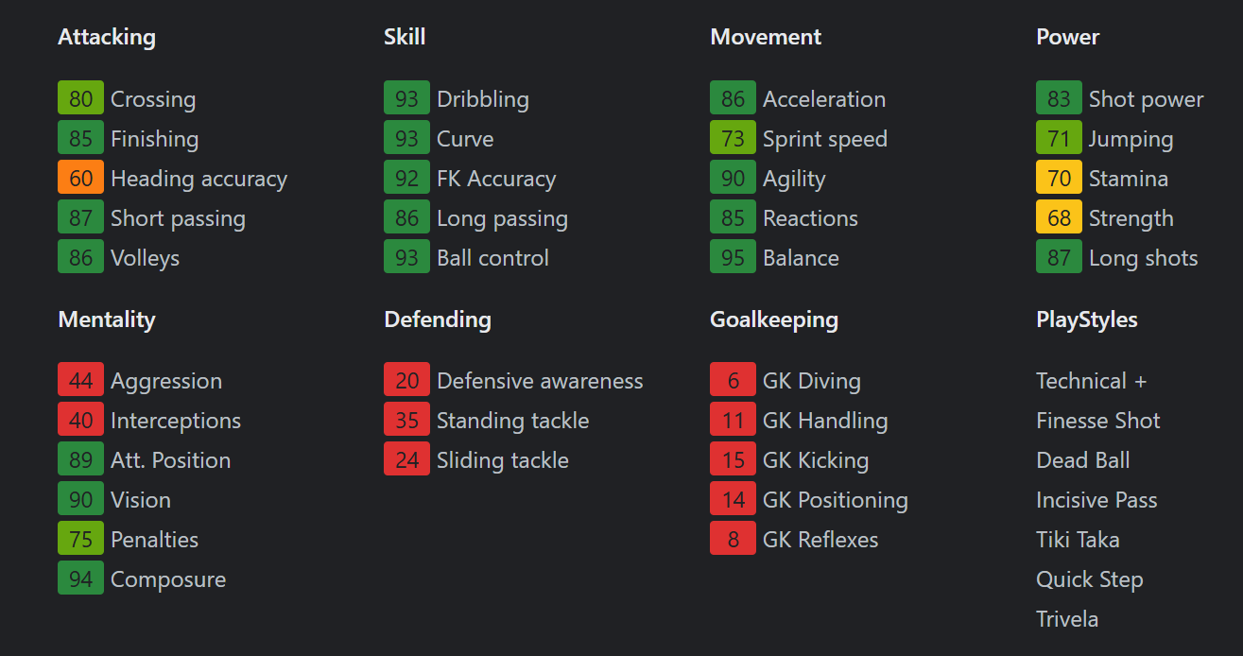
Sample Statistics: Lionel Messi
Notes:
Joseph

Slide 6
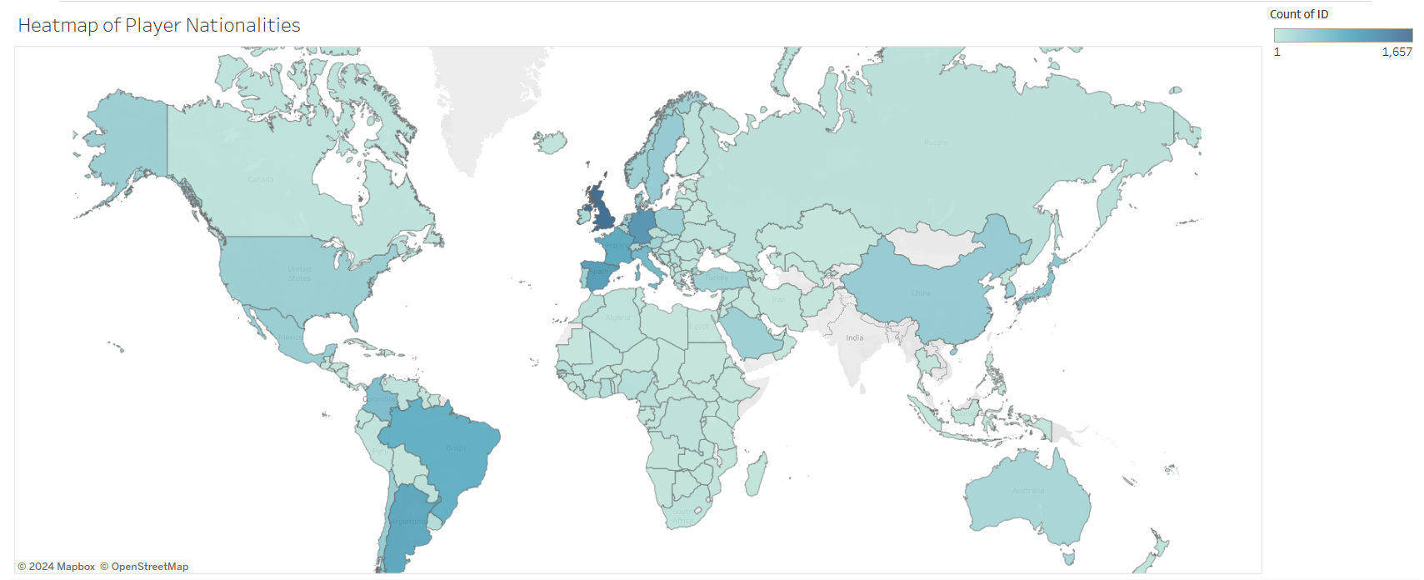
Heatmap of Player Nationalities
Notes:
Joseph

Slide 7
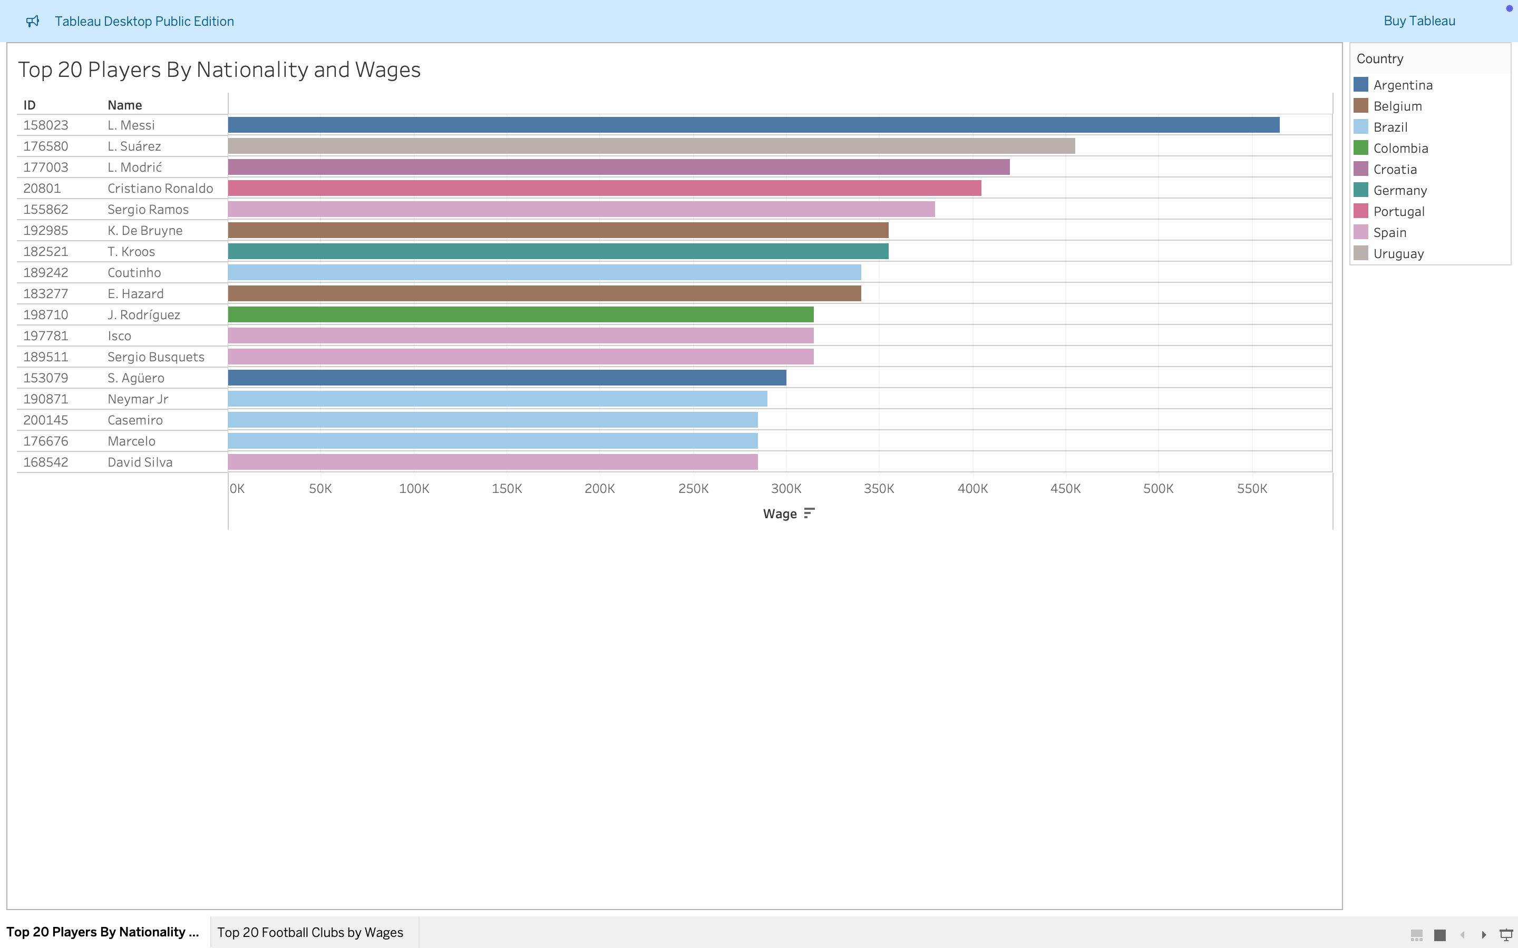
Top Paid Players by Nationality
Notes:
Joseph

Slide 8
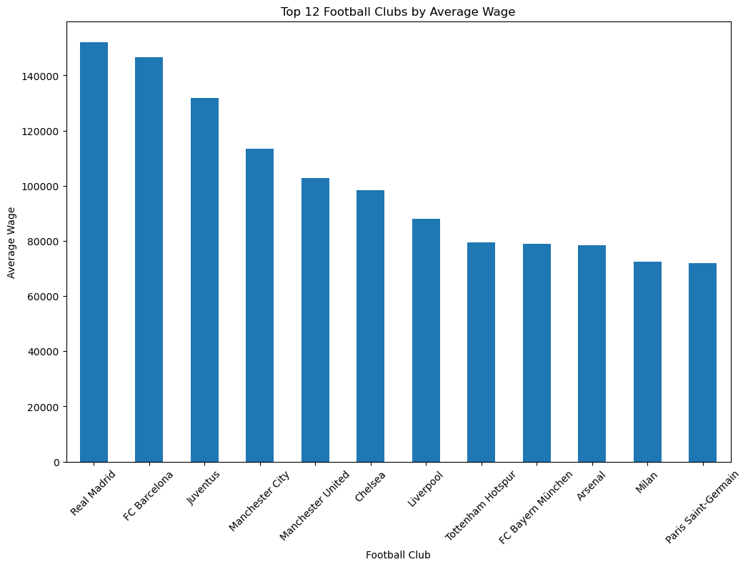
Football Clubs with Highest Average Wages
Notes:
Joseph

Slide 9

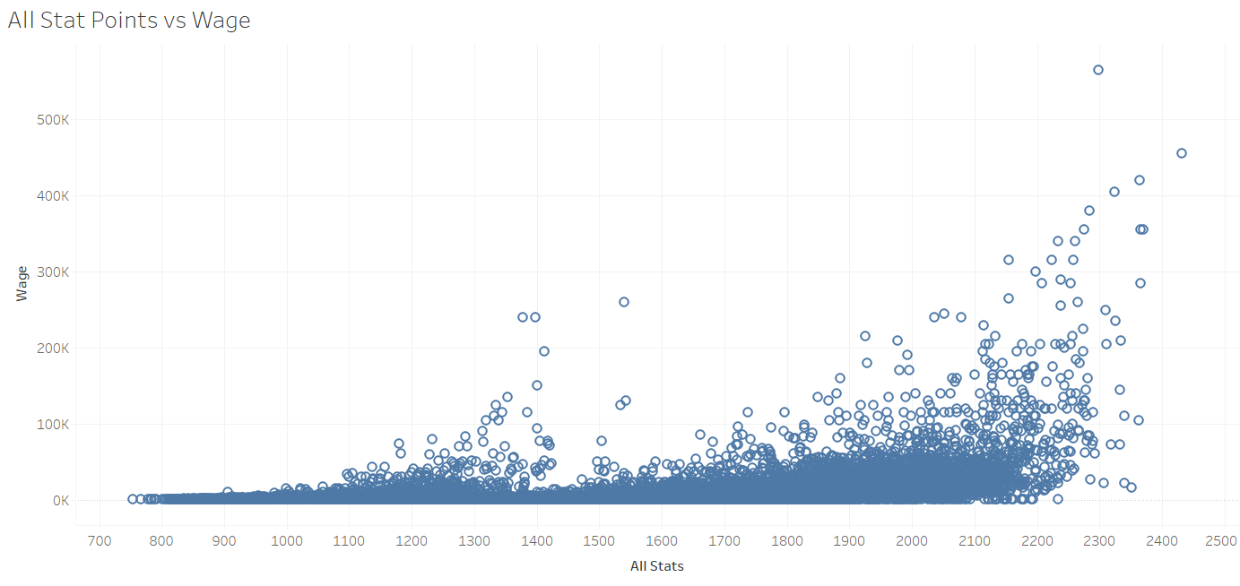
Sum of Stat Points vs Wage
Notes:
Micah

Slide 10
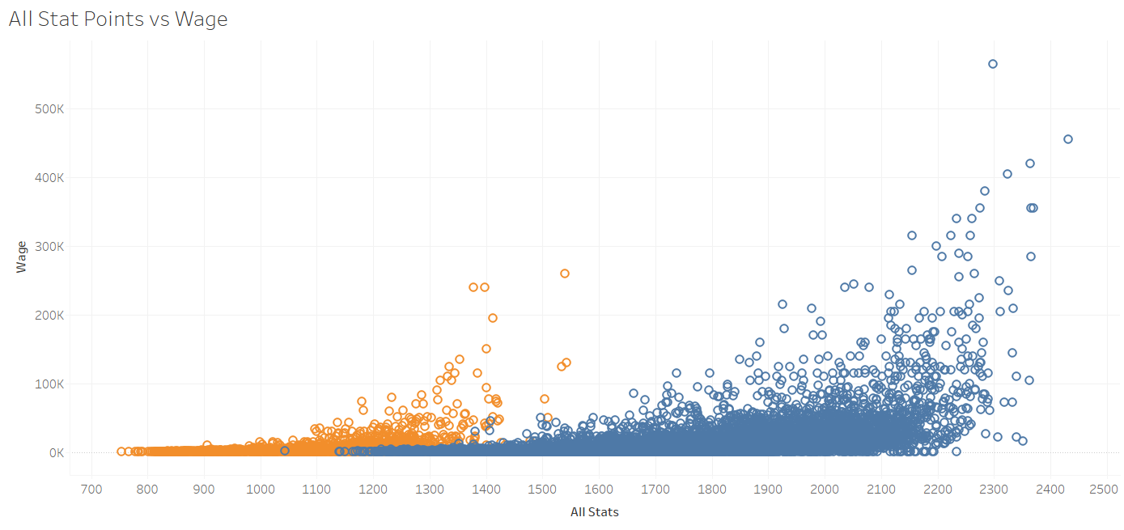
Sum of Stat Points vs Wage (Goalkeepers in Orange)

Slide 11
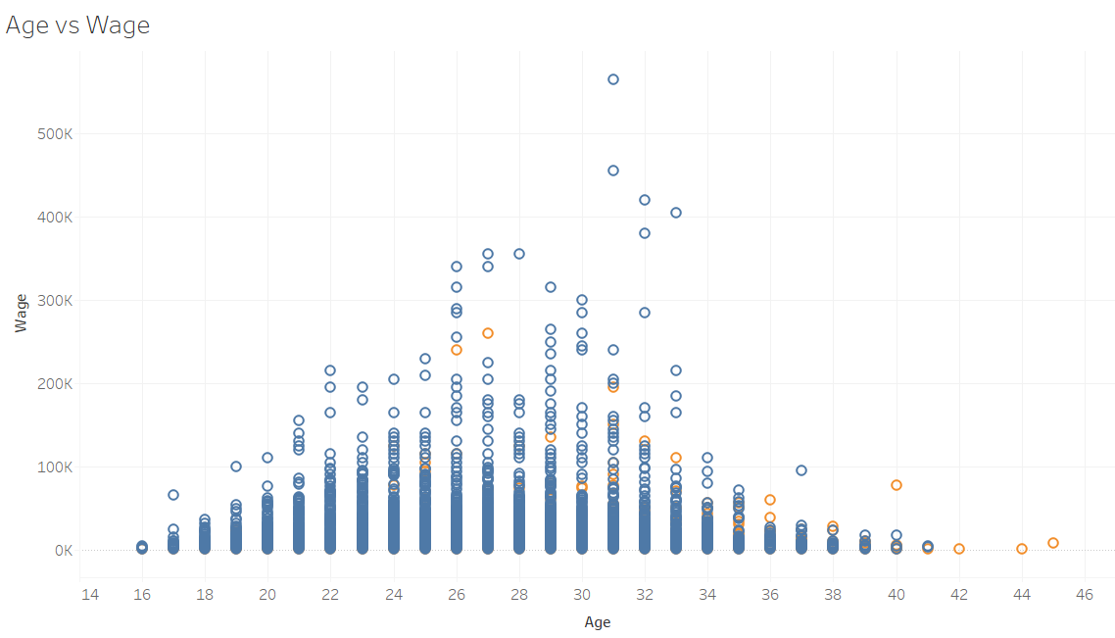
Age vs Wage
Notes:
Micah

Slide 12

Cleaning the Data
Removed goalkeepers and goalkeeping data
Removed players without club affiliations/wages
Quantified dominant foot
Removed non-numeric categories
Deleted days joined column
Notes:
Micah

Slide 13

Model Results
Model | R-squared
Linear Regression | 0.533
Random Forest | 0.804
KNN 2 | 0.560
KNN 5 | 0.568
KNN 12 | 0.618
SVC Linear | 0.278
SVC RBF | 0.285
XGBoost | 0.810
Neural Network | 0.636
80/20 Training-Testing ratio
-Linear, KNN, SVC weak
NN inconsistent
Random Forest, XGBoost strong
Notes:
Jacob

Slide 14

Conclusions
Sample text
Notes:
Jacob

